Slide 1


Slide 2

A relational database a collection of tables of data all of which are formally described and organized according to the relational model.
The relationships between the tables in a database correspond to the relationships between the entities (tables) they represent.

Slide 3
How the tables in a relational database are related:
The tables in a relational database are related to each other through their key columns. A foreign key identifies a primary key in another table. A table may contain one or more foreign keys.
When you define a foreign key for a table in SQL Server, you can’t add rows to the table with the foreign key unless there’s a matching primary key in the related table.

Slide 4

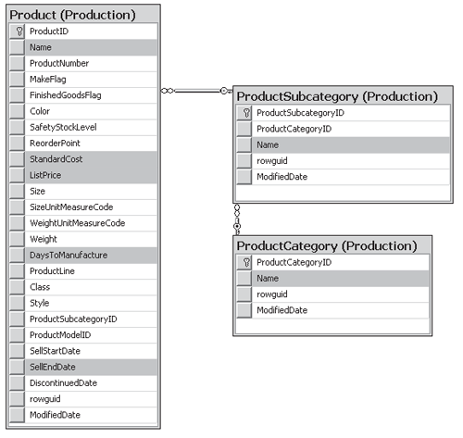

Slide 5
How the tables in a relational database are related:
The relationships between the tables in a database correspond to the relationships between the entities they represent.
There are three types of relationships between tables:
  one-to-many relationship (most common type)
  one-to-one relationship
  many-to-many relationship
Slide <number>

Slide 6
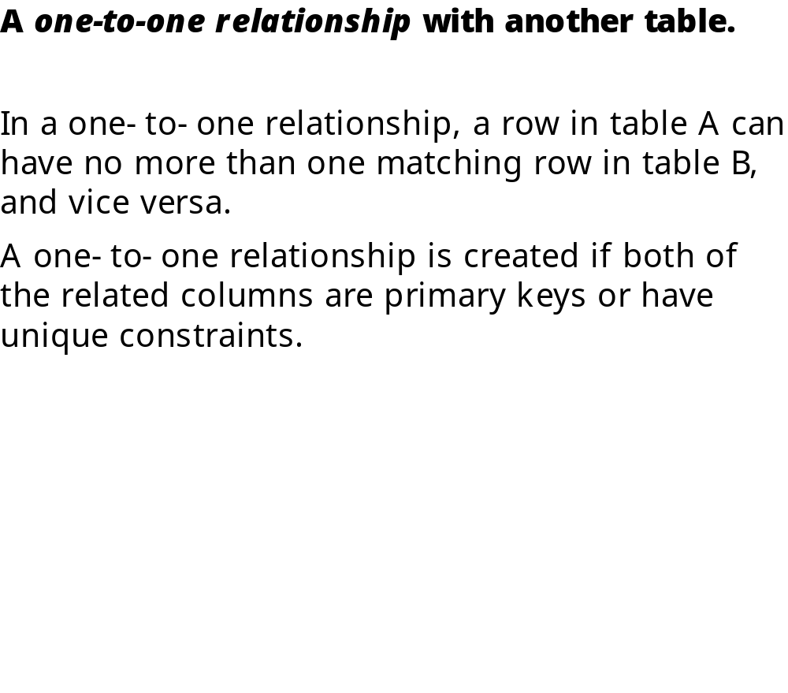
Slide <number>

Slide 7
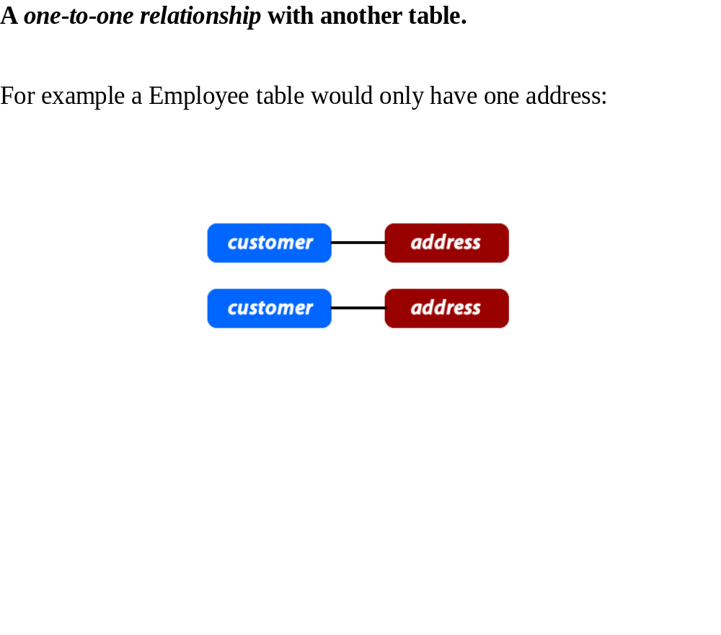
Slide <number>

Slide 8
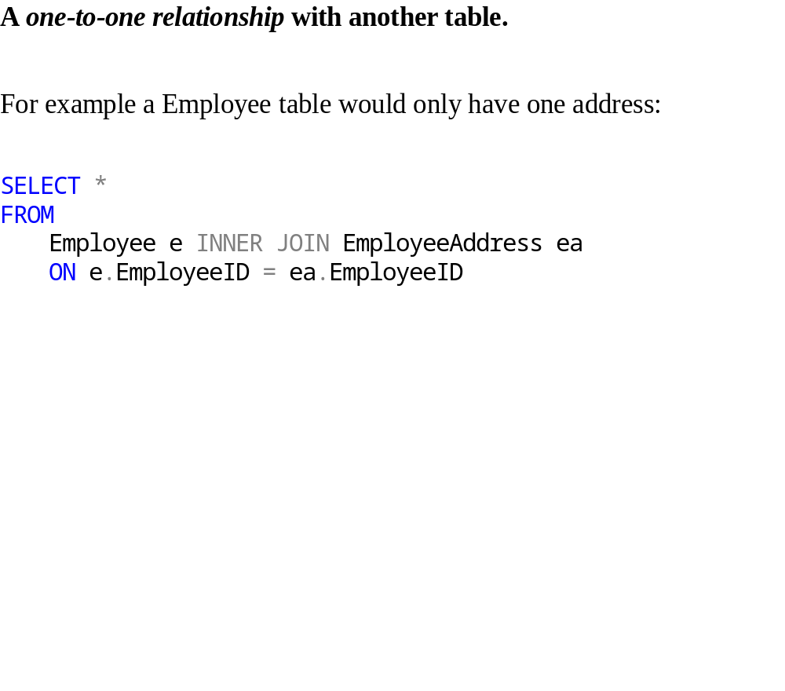
Slide <number>

Slide 9
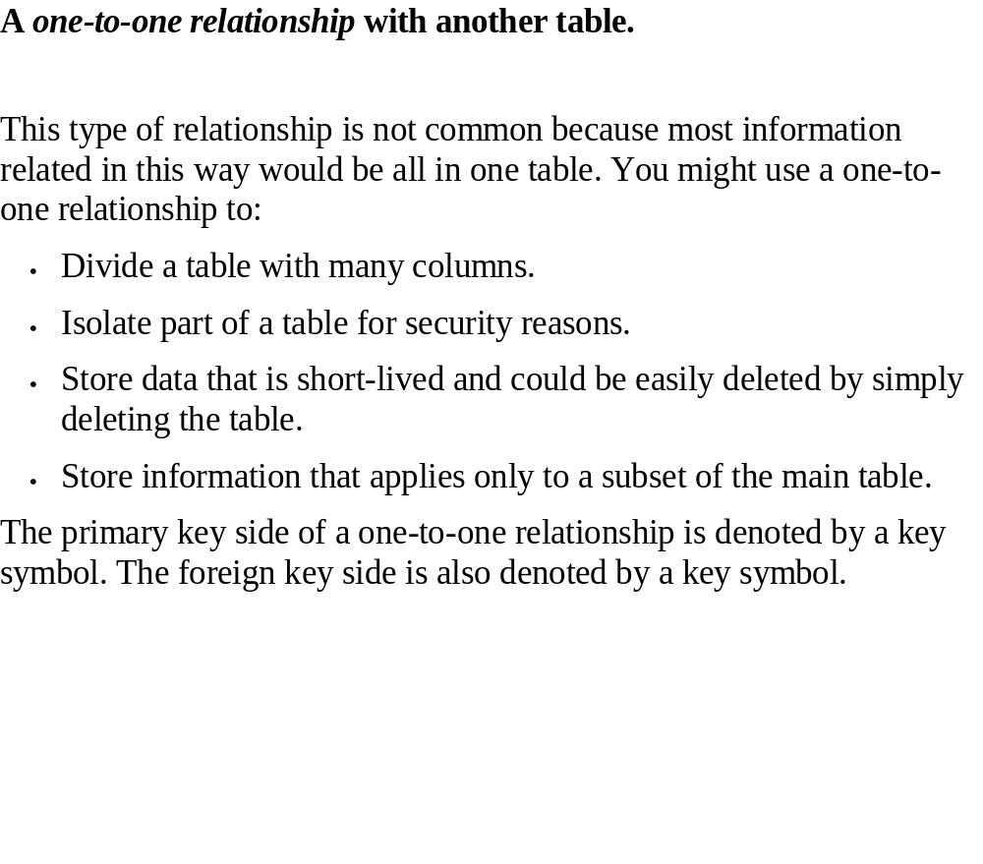
Slide <number>

Slide 10
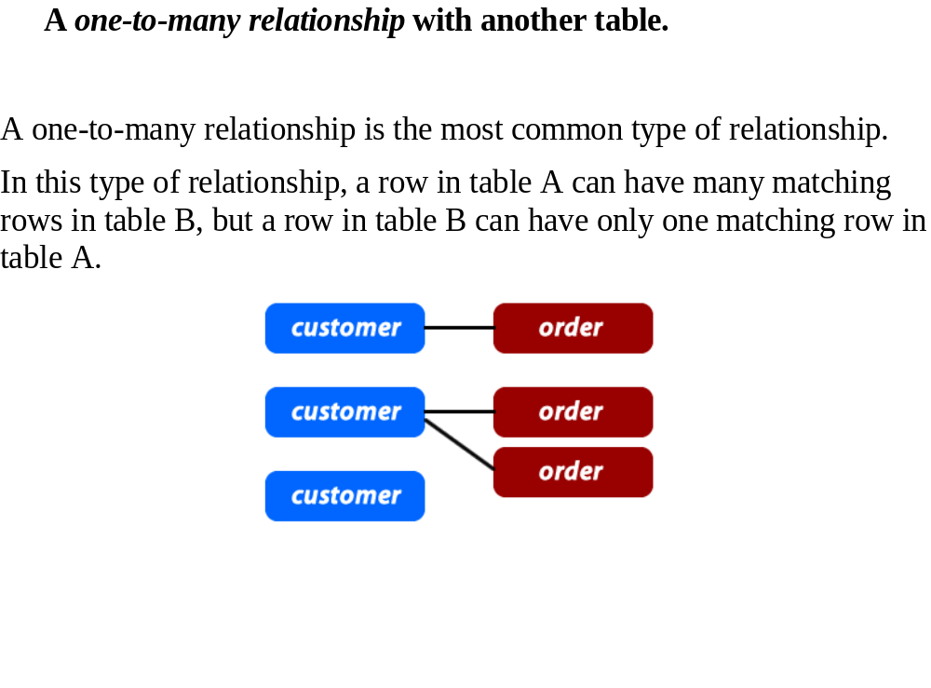
Slide <number>

Slide 11
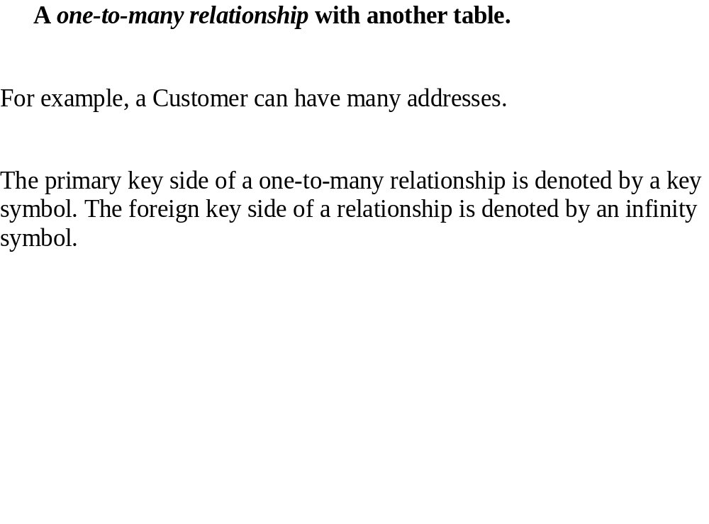
Slide <number>

Slide 12
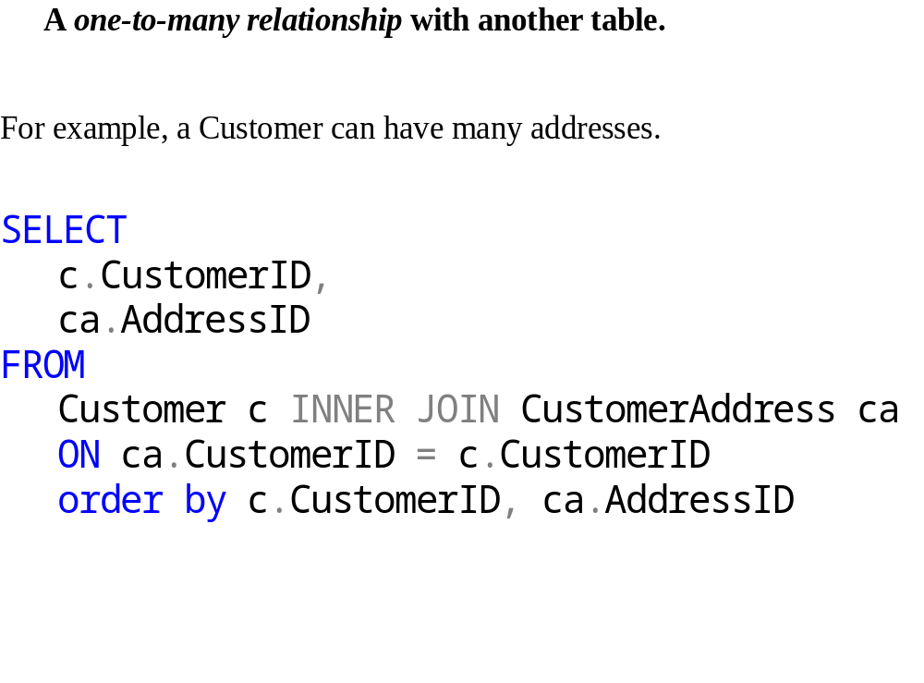
Slide <number>

Slide 13
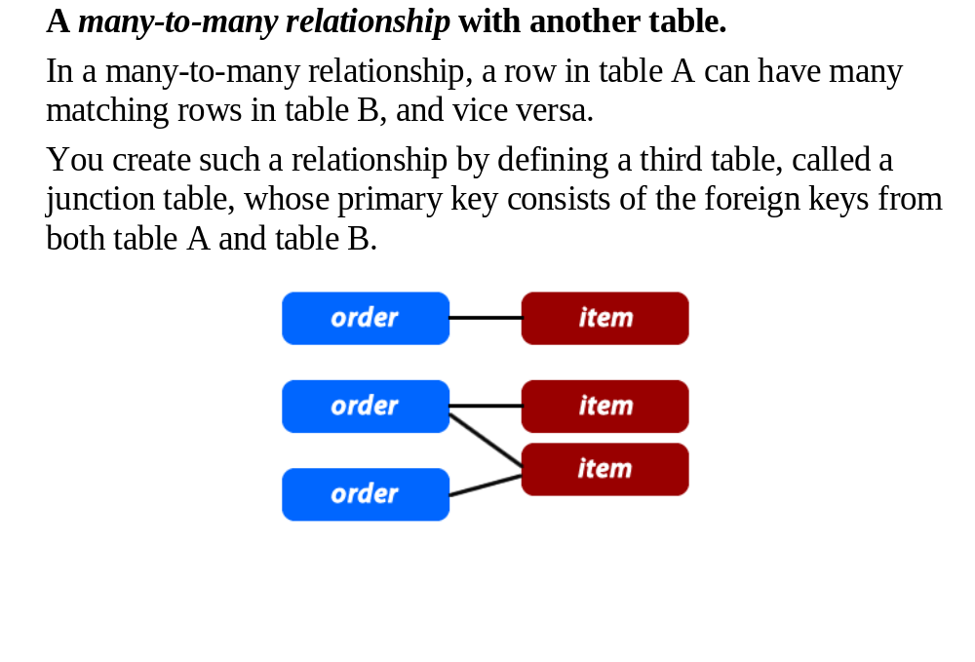
Slide <number>

Slide 14
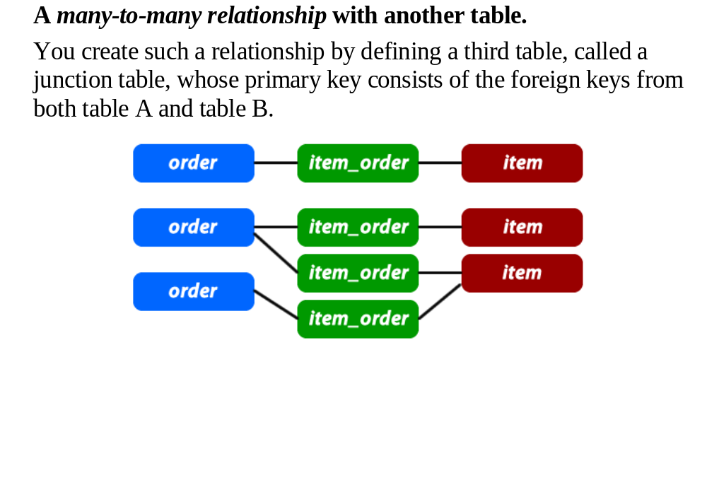
Slide <number>

Slide 15
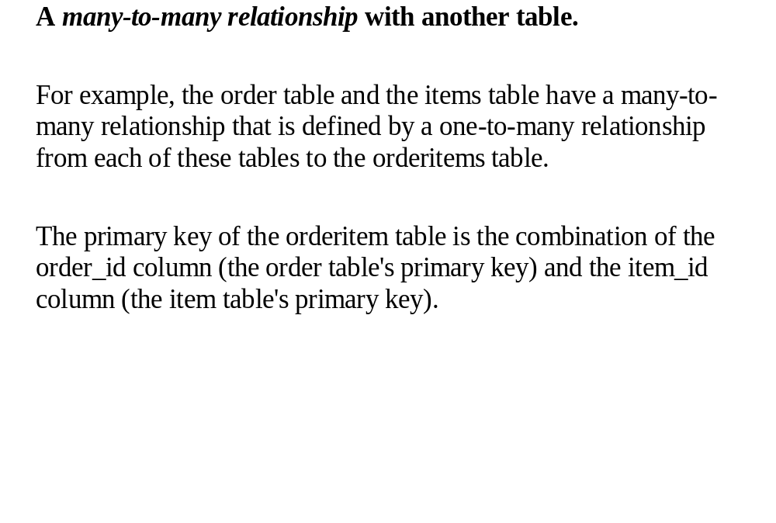
Slide <number>

Slide 16
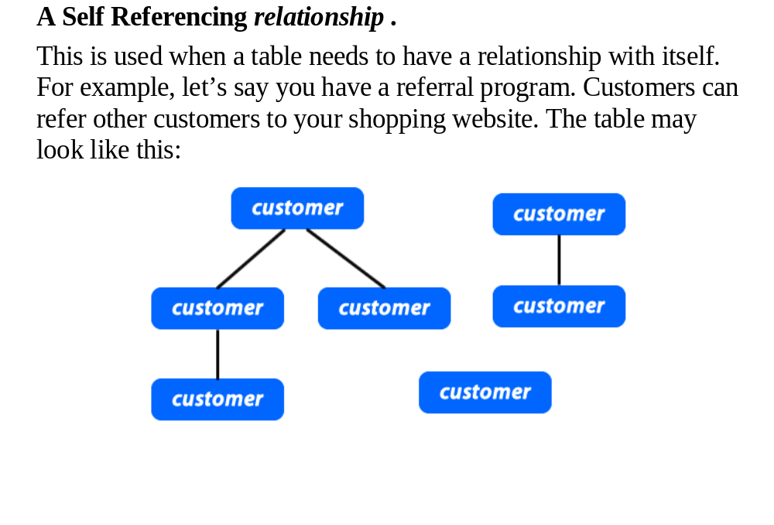
Slide <number>

Slide 17
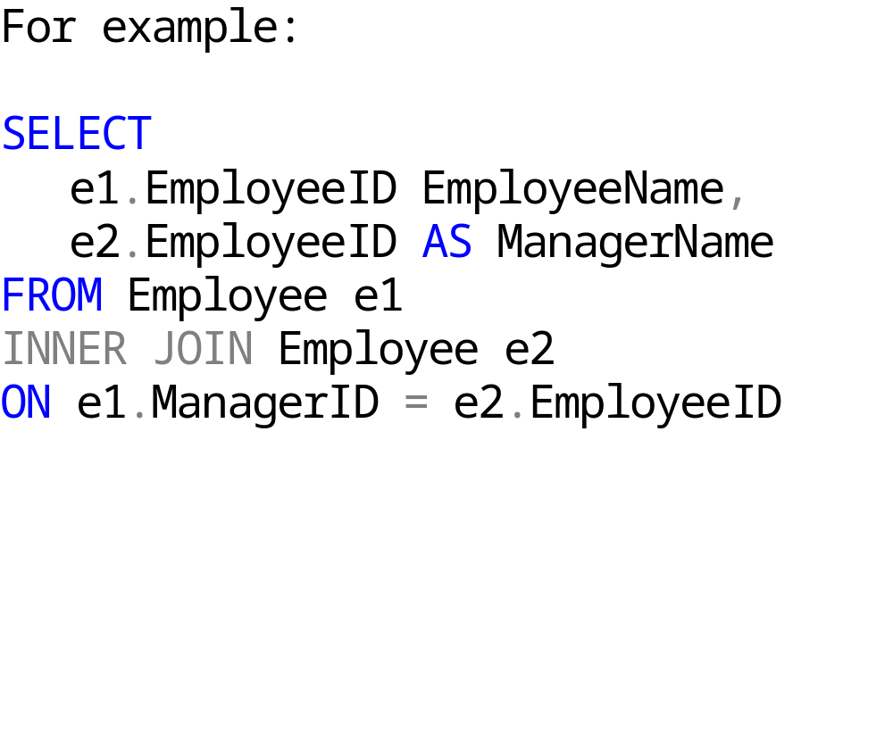
Slide <number>

Slide 18
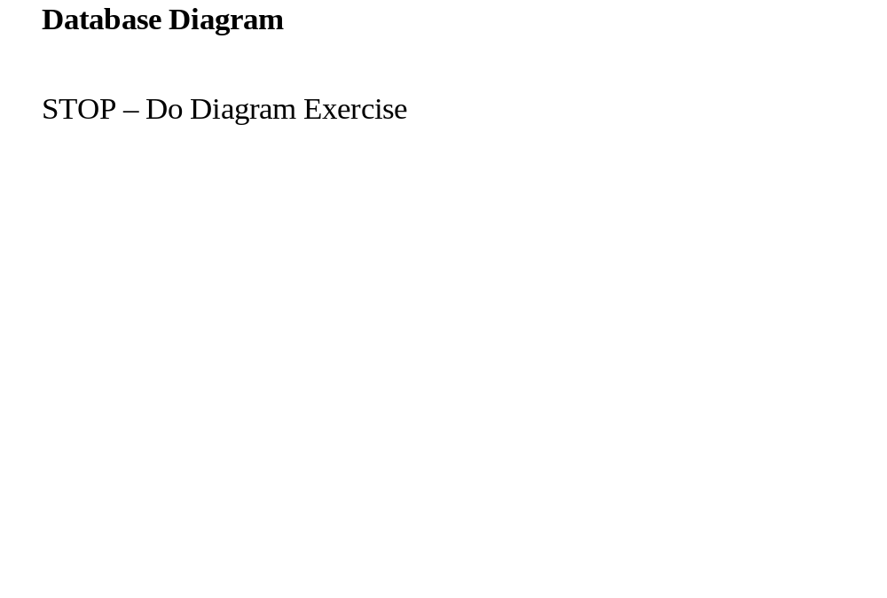
Slide <number>

Slide 19
A database is just not tables. A database is a system of:
Tables
Views
Stored Procedures
Functions
User Defined Data Types.
All of these objects combine together to make a
database and support a relational database.

Slide 20
The benefits of a database:
Data entry, updates and deletes will be efficient
Data retrieval, summarization and reporting will be efficient
It will behave predictably
Since data stored in database is somewhat self-documenting
Changes to database schema are easy to make

Slide 21

Joining Tables
Combining Queries

Slide 22

A relational database is a database that stores information about both the data and how it is related.
Each database is a collection of related tables.
Each table is a physical representation of an entity or object that is in a tabular format consisting of columns and rows.

Slide 23
The primary keys within a database are used to define the relationships among the tables.
When a PK migrates to another table, it becomes a foreign key in the other table.

Slide 24
By using joins, you can retrieve data from two or more tables based on logical relationships between the tables.
SQL JOIN joins together two tables on a matching table column, ultimately forming one single temporary table. The key word here is temporary.
The tables themselves remain intact, and running a JOIN query does not in any way change the data or table structure.

Slide 25
In order to perform a JOIN , we need a few pieces of information:
  the name of the table and
  column we want to join on and a condition to meet for the JOIN to happen.

Slide 26
A join condition defines the way two tables are related in a query by:
  Specifying the column from each table to be used for the join. A typical join condition specifies a foreign key from one table and its associated key in the other table.
  Specifying a logical operator (for example, = or <>,) to be used in comparing values from the columns.

Slide 27
Implicit table JOINs
SELECT *
FROM employee, department
WHERE employee.DepartmentID = department.DepartmentID
Explicit table JOINs
SELECT *
FROM employee
INNER JOIN department
ON employee.DepartmentID = department.DepartmentID

Slide 28
Best Practice is to use Explicit JOINs. Here is basic SQL syntax:
SELECT
  Column_Name,
  Column_Name
FROM
  Table_name1 t1 INNER JOIN Table_name2 t2
  ON t2.column_name = t1.column_name

Slide 29
Example:
SELECT
  Column_Name,
  Column_Name
FROM
  Table_name1 t1 INNER JOIN Table_name2 t2
  ON t2.column_name = t1.column_name

Slide 30
Both inner and outer joins can be used to combine data from two or more tables; however, there are some key differences
Though both inner and outer joins include rows from both tables when the match condition is successful, they differ in how they handle a false match condition
Inner joins don’t include non-matching rows; whereas, outer joins do include them.

Slide 31
Inner joins don’t include non-matching rows; whereas, outer joins do include them.
An inner join is used to return results by combining rows from two or more tables.
In its simplest case, where there is no join condition, an inner join would combine all rows from one table with those from another.

Slide 32
Inner joins don’t include non-matching rows; whereas, outer joins do include them.
An inner join is used to return results by combining rows from two or more tables.
In its simplest case, where there is no join condition, an inner join would combine all rows from one table with those from another.

Slide 33
If a customer has more than one address, then more than one match is made.
From this you can see we may get more rows returned than we have for each customer

Slide 34
For example:
SELECT
c.CustomerID,
ca.AddressID
FROM
Customer c INNER JOIN CustomerAddress ca
ON ca.CustomerID = c.CustomerID
order by c.CustomerID, ca.AddressID

Slide 35

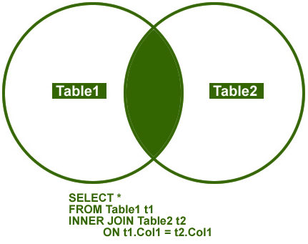
This JOIN returns rows when there is at least one match in both the tables.
INNER JOIN option is considered to be the most common join needed in applications and/or queries.

Slide 36
This query returns Name form Contact table and Title from Employee table.
SELECT c.FirstName,
c.LastName,
e.Title
FROM Employee AS e
INNER JOIN Contact AS c
ON e.ContactID = c.ContactID
ORDER BY c.LastName

Slide 37
STOP – Do exercise e 14

Slide 38
An outer join is used to return results by combining rows from two or more tables.
But unlike an inner join, the outer join will return every row from one specified table, even if the join condition fails

Slide 39
Take the Contact table example above. If we want to list every Contact regardless of whether they had a credit card , then using an outer join would make it so.
So when a LEFT OUTER JOIN is used, all rows for the table in the FROM clause are included in the result, even if a match isn’t found with the other table

Slide 40
For example:
SELECT
  c.ContactID,
  cc.CreditCardID
FROM
Contact c Left Outer JOIN ContactCreditCard cc
ON cc.ContactID = c.ContactID
Order by cc.CreditCardID

Slide 41
Inner joins can be specified in either the FROM or WHERE clauses.
Outer joins can be specified in the FROM clause only.
The join conditions, combined with the WHERE and HAVING search conditions, control the rows that are selected from the base tables referenced in the FROM clause.

Slide 42

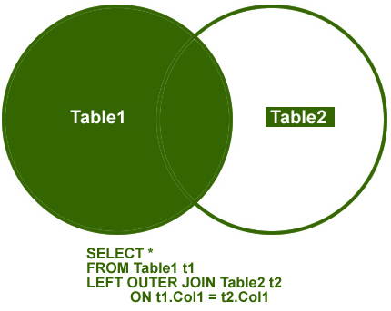
This join returns all the rows from the left table in conjunction with the matching rows from the right table. If there are no columns matching in the right table, it returns NULL values.
Another item to keep in mind is that the LEFT and RIGHT OUTER JOIN logic is opposite of one another. So you can change either the order of the tables in the specific join statement or change the JOIN from left to right or vice versa and get the same results.

Slide 43
To include all products, regardless of whether a review has been written for one, use an ISO left outer join. The following is the query:
SELECT
p.Name,
pr.ProductReviewID
FROM Product p LEFT OUTER JOIN ProductReview pr
ON p.ProductID = pr.ProductID

Slide 44
STOP – Do exercise 15

Slide 45

A table can be joined to itself in a self-join.
Because this query involves a join of the Employee table with itself you must give the Employee table two different aliases (e1 and e2) in the FROM clause.
We want to see which employee is being managed by which Manager.

Slide 46
For example, you can use a self-join to find the products that are supplied by more than one vendor.
SELECT
e1.ManagerID AS ManagerID,
e2.EmployeeID EmployeeID
FROM Employee e1
INNER JOIN Employee e2
ON e2.ManagerID = e1.EmployeeID
ORDER BY e1.ManagerID

Slide 47

STOP – Do Exercise 16

Slide 48
Specifying the join conditions in the FROM clause helps separate them from any other search conditions that may be specified in a WHERE clause
This is the recommended method for specifying JOINs.
When multiple tables are referenced in a single query, all column references must be unambiguous.

Slide 49
Any column name that is duplicated between two or more tables referenced in the query must be qualified with the table name.
When a column name is not duplicated in two or more tables used in the query, references to it do not have to be qualified with the table name.

Slide 50
The ability to join tables is one of the most powerful features of SQL
Joins are the mechanism used to associate tables within SELECT statement
Joins can be part of FROM or WHERE cluase

Slide 51
The key is to not have multiple occurrences of the same data in a table.
Relational tables are designed to split data into multiple tables.
You must have an understanding of relational database design

Slide 52
Each table has a unique identifier for each row know as Primary Keys.
For example, a vendor table would have only vendor data and a Priamary key named vend_id

Slide 53
We would have another table called products which stores only data about products.
The only vendor data it would store is the vendor_id column.
This is called the Foreign Key. It relates the product table to the vendor table.

Slide 54
This Foreign Key (vend_id) in the products table allows you use the vendor table to retrieve vendor data .

Slide 55
STOP – Do exercise 17

Slide 56

In SQL Server you have the ability to combine multiple datasets into one comprehensive dataset by using the:
UNION operator or
UNION ALL operator.

Slide 57
There is a big difference in how these work as well as the final result set that is returned, but basically these commands join multiple datasets that have similar structures into one combined dataset.

Slide 58
UNION - this command will allow you to join multiple datasets into one dataset and will remove any duplicates that exist.
Basically it is performing a DISTINCT operation across all columns in the result set.

Slide 59
UNION ALL - this command again allows you to join multiple datasets into one dataset, but it does not remove any duplicate rows.
Because this does not remove duplicate rows this process is faster, but if you don't want duplicate records you will need to use the UNION operator instead.

Slide 60
In this first example we are using the UNION ALL operator against the Employee table from the AdventureWorks database.
This is probably not something you would do, but this helps illustrate the differences of these two operators.
There are 290 rows in table dbo.Employee.

Slide 61
SELECT * FROM dbo.Employee
UNION ALL
SELECT * FROM dbo.Employee
UNION ALL
SELECT * FROM dbo.Employee

Slide 62
When this query is run the result set has 870 rows.
This is the 290 rows returned 3 times.

Slide 63
In this next example we are using the UNION operator against the Employee table again from the AdventureWorks database.

Slide 64
SELECT * FROM dbo.Employee
UNION
SELECT * FROM dbo.Employee
UNION
SELECT * FROM dbo.Employee

Slide 65
When this query is run the result set has 290 rows.
Even though we combined the data three times the UNION operator removed the duplicate records and therefore returns just the 290 unique rows.

Slide 66
STOP – Do exercise 18

